Slide 1
DeepFace vs FER: A Comparative Analysis of Emotion Recognition Technologies
Georg Iber, JKU Linz, Amir Suleimenov

Slide 2
Content of the Talk
Introduction to Emotion Recognition
DeepFace and FER
Prototype Approach
Comparative Analysis
Conclusion

Slide 3


Emotion Recognition Capabilities/Importance
Marketing
Education
Healthcare
Challenges
Detection-Process

Slide 4

DeepFace
Advantages
High accuracy
Impact on future technologies
Limitations
Big training data

Slide 5
FER (Facial Expression Recognition)
Advantages
Small training set
Limitations
Performance
Lighting, pose variation…

Slide 6
Prototype Approach
Python
OpenCV
DeepFace
FER (Facial Emotion Recognition)
Seaborn

Slide 7
Comparative Analysis
Categories
Simple
Intermediate
Complex

Slide 8




Simple Image
Good lighting
Straight look into the camera
Easy to get Emotions

Slide 9
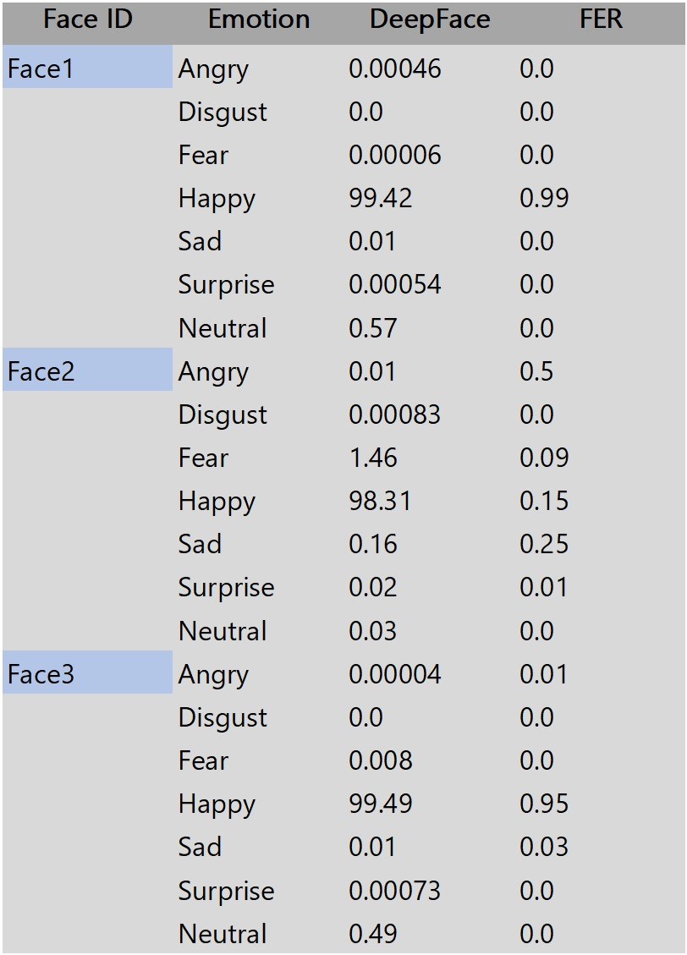
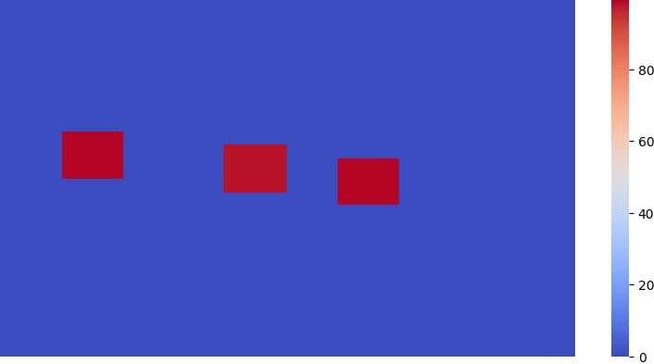
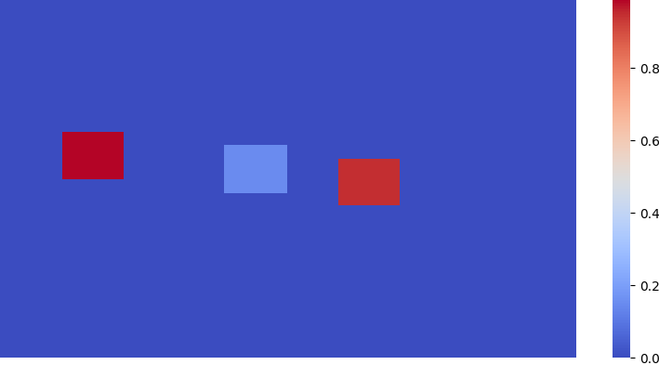
Simple Image Result
Deepface:
FER:

Slide 10



Intermediate Image
Good lighting
Look away from the camera
Harder emotions

Slide 11
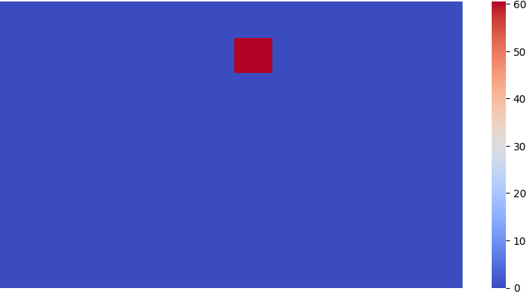
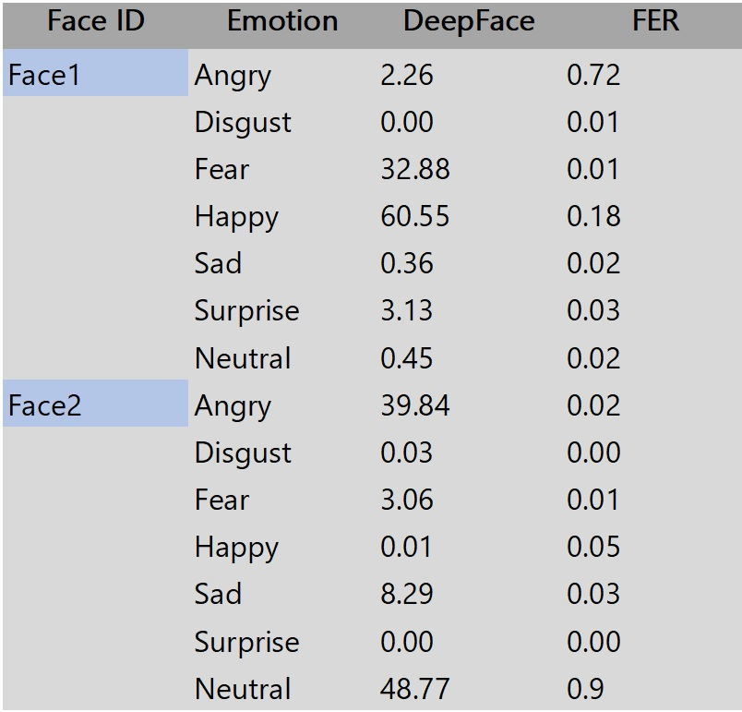
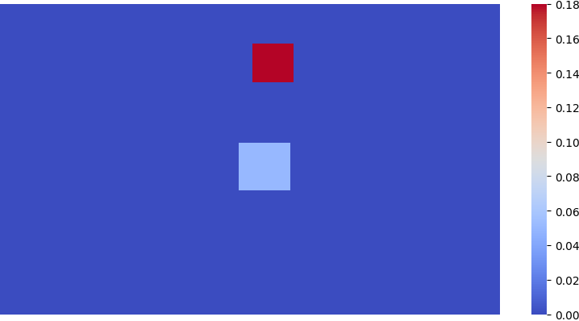
Intermediate Image Result
Deepface:
FER:

Slide 12



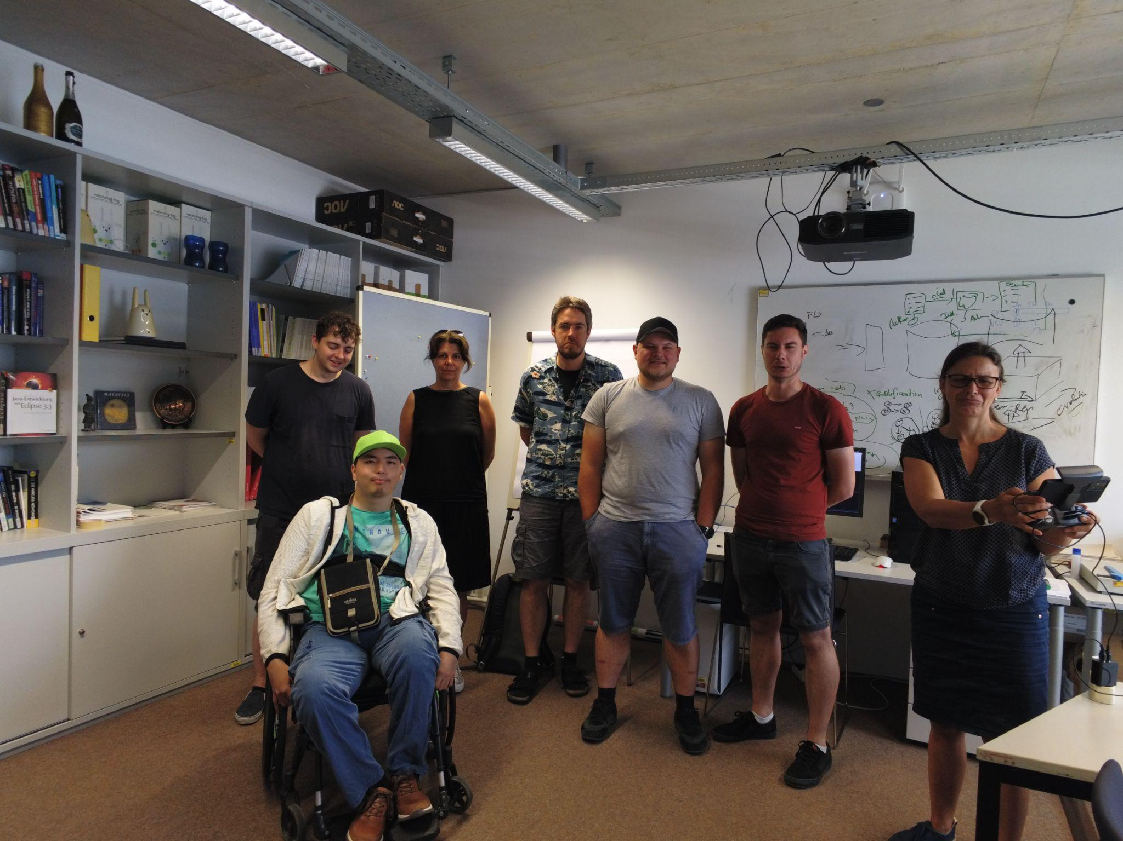



Complex Image
Worse lighting
Harder Emotions

Slide 13
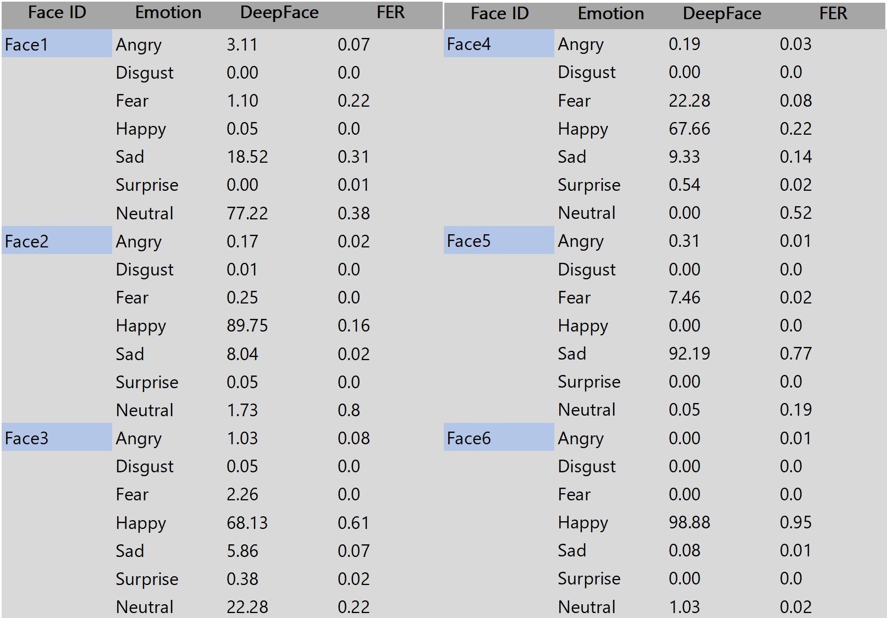
Complex Image Result

Slide 14
Conclusions
Scale of Scoring
Variance in Results
Summarization

